Slide 1
CSE 7302 – University Project Review- 4 Presentation Image based Animal Type Classification for cattle and buffaloes
Student Details
Name | Roll No
Harshitha. KJ | 20221CDV0026
Susmitha.S | 20221CDV0038
Greeshma | 20221CDV0040
Under the Supervision:
Mr. Sahabzada Betab Badar
Assistant Professor
School of Computer Science and Engineering
Presidency University
Name of the Program: B. Tech Computer Science and Technology (Devops)
Name of the HoD: Dr. Pravinthraja S
Name of the Program Project Coordinator: Dr. H M Manjula
Name of the School Project Coordinators: Dr. Sampath A K , Dr. Geetha A

Slide 2
Content:
Introduction
Literature Survey
Research Gap
Challenges faced in project
Proposed System Design
Advantages of proposed system/work
Tools & Technologies
References
Conclusion
Review Timeline
Github Link

Slide 3
Introduction:
Livestock such as cattle and buffaloes play a vital role in agriculture, dairy production, and the rural economy.
Proper identification of animal type is important for farm management, breeding, health monitoring, and insurance.
With the growth of artificial intelligence, computer vision can be used to automatically identify animals from images.
Image-based classification helps in distinguishing between cattle and buffaloes based on their visual features.
This system uses digital images of animals as input for classification.

Slide 4
Introduction Continued:
6. Machine learning and deep learning techniques analyze patterns such as shape, texture, horns, and body structure.

Slide 5
Literature Review:
Recent research demonstrates that Convolutional Neural Network (CNN) based deep learning models are highly effective for livestock image classification, achieving good accuracy in identifying animal species such as cows, buffaloes, sheep, and goats.
Most existing studies primarily focus on animal type identification or breed classification using supervised learning techniques. These works mainly address classification accuracy but do not extend toward complete livestock management solutions.
Only a limited number of studies attempt health analysis using visual features, and even these are restricted to basic symptom detection without systematic validation or explainability.

Slide 6
Literature Review Continued:
4. Additionally, many current livestock management systems rely on manual record keeping or RFID-based identification, which increases operational cost, requires physical tagging, and is prone to duplication, data inconsistency, and human error.

Slide 7
Research Gap & Motivation:
Identified Research Gaps
Existing systems do not provide a unique and persistent digital identity for each livestock animal.
There is no effective duplicate or fraud detection mechanism, leading to multiple registrations and misuse of records.
Health analysis is either very limited or completely absent, especially in terms of visual health risk indicators.
Most models operate as black boxes, lacking Explainable AI (XAI) features to justify predictions and build user trust.
Current solutions are not end-to-end systems; they lack proper integration of AI models, user interface, and database management.

Slide 8
Research Gap & Motivation Continued:
Motivation
The motivation of this work is to design and develop a complete AI-based smart livestock identification system that integrates deep learning, image processing, explainable AI, and database management to provide an accurate, transparent, and scalable solution for real-world livestock management.

Slide 9
Challenges Faced In Project:
High intra-class variance (different breeds have large visual diversity (such as the difference in appearance between Murrah and Surti buffaloes)) will make extracting distinguishing features for a possible convolutional neural network (CNN) to use for identification difficult.
Environmental noise can include background noise (such as mud, straw, and fencing) or inadequate rural lighting affecting the AI's ability to predict correctly.
Mislabeling of animals through alphabetical indexing of animals in Keras ($0$ for one animal and $1$ for a different animal) has also caused some label swap between buffalo and cattle in a model after it was deployed.
The AI was specifically attempting to classify non-animal visual data (cars and humans) as classifying livestock visual data using the "forced choice" protocol (instead of rejecting non-animal visual data).

Slide 10
Challenges Faced In Project:
5. Inference Latency: High Resource Usage of Machine Learning models results in slow access to results (low response time).
6. Identity Collision: No inherent AI system to identify “Double-Subsidy Fraud” occurring when one picture has been submitted multiple times for use to register.

Slide 11
Proposed System Overview:
AI-Based Smart Livestock Identification System
The proposed system is an intelligent, image-based livestock identification platform that utilizes deep learning and computer vision techniques to automate livestock analysis and management.
Key Features
Animal Type Identification: Automatic classification of livestock as cow or buffalo.
Breed Classification: Identification of specific breeds using deep learning models.
Digital Profile Creation: Creation of a unique digital identity for each animal, including image and metadata.

Slide 12
Proposed System Overview Continued:
4. Duplicate Detection: Prevention of multiple registrations using image feature similarity analysis.
5. Visual Health Risk Analysis: Detection of basic health risk indicators from visible features.
6. Explainable AI: Generation of heatmaps to visually explain AI decision-making.
Approach
The system follows an image-based automated analysis approach, where livestock images are processed through a CNN-based deep learning model to perform classification, analysis, and decision support with improved accuracy and transparency.

Slide 13
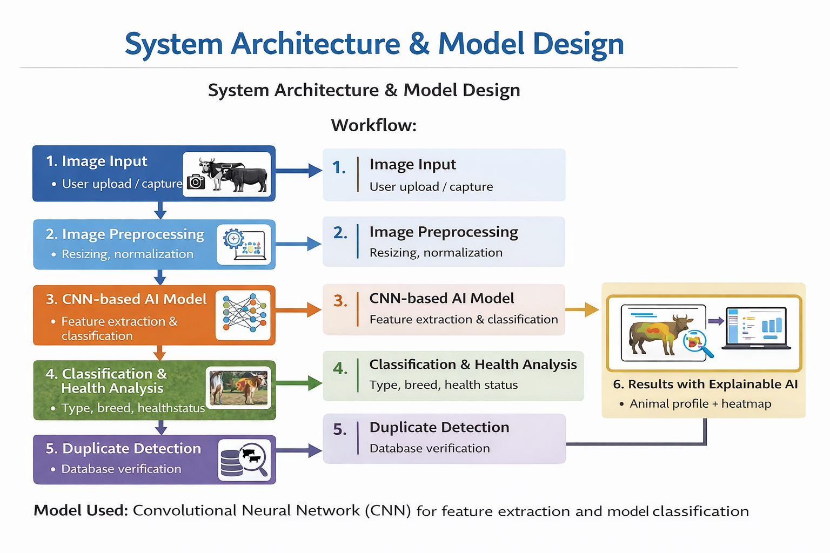
System Architecture & Model Design:
Workflow:
Image Input
Image Preprocessing
CNN-based AI Model
Classification & Health Analysis
Duplicate Detection
Results with Explainable AI
FIG 1: System Architecture and Model Design of AI-Based Smart Livestock Identification System

Slide 14
System Architecture & Model Design Continued: :
Model Used:
Convolutional Neural Network (CNN) for feature extraction and classification.

Slide 15
Advantages Of The Proposed System:
Non-invasive identification: Painful physical tagging (ear tags/branding) is replaced with a touchless, stress-free AI biometric scan.
Fraud prevention: Duplicate registration detection using MD5 cryptography eliminates the possibility of double subsidy theft by blocking access to these duplicate registrations in real time.
High-precision filtering: Implementation of a soft maximum confidence threshold (85%) automatically rejects all non-livestock images as unknown.
Digital id with resilient authentication: Permanent digital fingerprint that will never be lost, switched out, or altered like a physical tag.
Live analytics and data monitoring: Real-time market value/health intelligence dashboard for data-driven decisions in agri-business. Optimized for edge processing and performance: High accuracy, low latency on standard web browsers due to MobileNetV2 architecture optimization.

Slide 16
Tools & Technologies Used:
AI & Image Processing:
Python - Core programming language.
TensorFlow / PyTorch – Deep learning frameworks.
Convolutional Neural Networks (CNN) – Image feature extraction and classification.
OpenCV – Image preprocessing and enhancement.
User Interface
Flutter / ReactJS – User-friendly interface for image upload and result display.

Slide 17
Tools & Technologies Used Continued:
Database
SQLite / PostgreSQL – Storage of animal images, profiles, and metadata.
Visualization
Heatmaps (Explainable AI) – Visual explanation of AI predictions.
Result Dashboards – Display of classification and health analysis outputs.

Slide 18
References:
[1] Image-Based Breed Recognition of Cattle and Buffaloes of India” (2026) https://www.researchgate.net/publication/399687026_Image_Based_Breed_Recognition_of_Cattle_and_Buffalos_of_India
[2] Image-Based Breed Recognition for Cattle and Buffaloes Using Deep Learning” (2025) https://ijirt.org/article?manuscript=190698
[3] Image-Based Breed Recognition of Indian Cattle and Buffaloes Using YOLOv12” (2025) https://doi.org/10.22214/ijraset.2025.76311
[4] Deep Learning Based Individual Cattle Face Recognition using Transfer Learning” (2025) https://www.researchgate.net/publication/383486759_Deep_Learning_based_Individual_Cattle_Face_Recognition_using_Data_Augmentation_and_Transfer_Learning

Slide 19
References:
[5] Deep Learning-Based Buffalo Identification using Muzzle Patterns (2025) https://aab.copernicus.org/articles/68/473/2025/
[6] Buffalo Identification using CNN Models (ResNet & EfficientNet) (2025) https://lifescienceglobal.com/pms/index.php/JBS/article/view/10227
[7] Cattle Identification using Multi-Feature Fusion and Deep Learning (2024) https://www.nature.com/articles/s41598-024-76718-x
[8] AI-Based Real-Time Cattle Identification using YOLOv8 (2024) https://pmc.ncbi.nlm.nih.gov/articles/PMC11294341/

Slide 20
References:
[5] Deep Learning-Based Buffalo Identification using Muzzle Patterns (2025) https://aab.copernicus.org/articles/68/473/2025/
[6] Buffalo Identification using CNN Models (ResNet & EfficientNet) (2025) https://lifescienceglobal.com/pms/index.php/JBS/article/view/10227
[7] Cattle Identification using Multi-Feature Fusion and Deep Learning (2024) https://www.nature.com/articles/s41598-024-76718-x
[8] Universal Bovine Identification via Deep Metric Learning” (2024) https://arxiv.org/abs/2404.00172
[9] MultiCamCows2024 Dataset for AI-Based Cattle Identification” (2024) https://arxiv.org/abs/2410.12695

Slide 21
Outcome & Conclusion:
Outcome
Comprehensive literature survey completed and research gaps clearly identified.
Limitations of existing livestock identification systems analyzed.
Proposed system architecture finalized based on identified gaps.
CNN-based AI model design validated for classification and feature extraction.
Health risk analysis and duplicate detection concepts finalized.
Explainable AI approach selected to improve transparency and trust.
Tools and technologies finalized for implementation phase.

Slide 22
Outcome & Conclusion Continued:
Conclusion
The proposed AI-based smart livestock identification system provides a scalable, reliable, and explainable solution to real-world livestock management challenges. By integrating deep learning, image processing, database management, and explainable AI, the system overcomes the limitations of traditional and existing automated approaches. The finalized design is technically feasible, academically strong, and suitable for practical deployment, making it well-aligned with the objectives of the project and ready for implementation in the next phase.

Slide 23
Review Timeline:
Review 4
Final Review
Review 2
Review 3
Review 1
Overview of the problem domain, identification of project title, briefing of the problem statement, objectives, and understanding the project scope and workflow plan.
13/01/26
Detailed literature survey on existing livestock identification systems, identification of research gaps, and finalization of the proposed system design, architecture, and tools.
11/01/26
Progress on implementation including dataset collection, image preprocessing, CNN model development, training, testing, and initial result analysis.
/02/26
Progress on complete system integration including duplicate detection, health risk analysis, Explainable AI visualization, database integration, and user interface development.
/04/26
Submission of final report, source code, and presentation, followed by system demonstration and viva voce evaluation by internal and external examiners.
/04/26

Slide 24
Github Link:
https://github.com/20221CDV0026/Image-based-Animal-Type-Classification-for-cattle-and-buffaloes-

Slide 25

Q&A

Slide 26
Thank you!

